Slide 1

DIRECTORY SERVICES

Slide 2
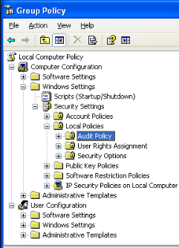
What is directory?
A Directory is a collection of information about objects arranged in some order that gives details about each object.

Slide 3
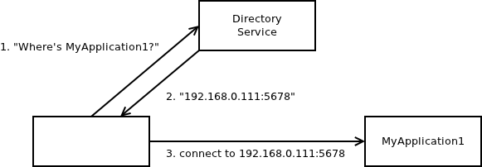
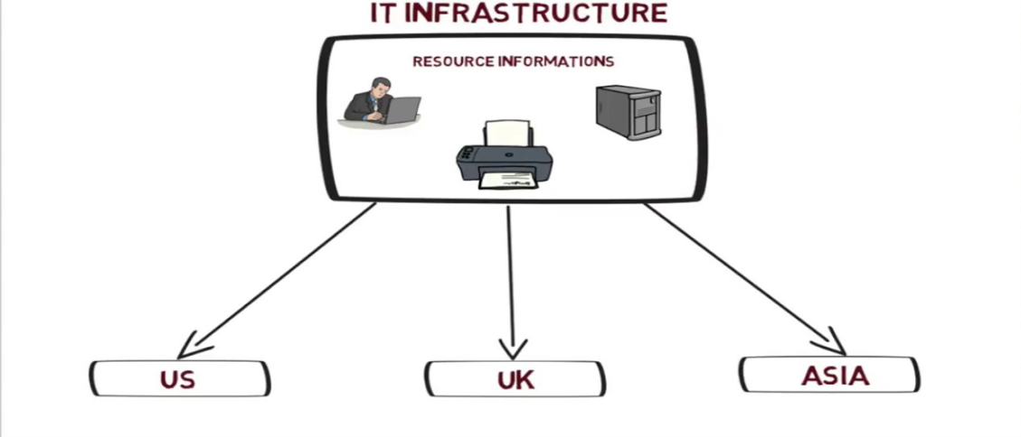
What is Directory services?
Directory services are software systems that store, organize and provide access to the directory information in order to unify network resource.

Slide 4
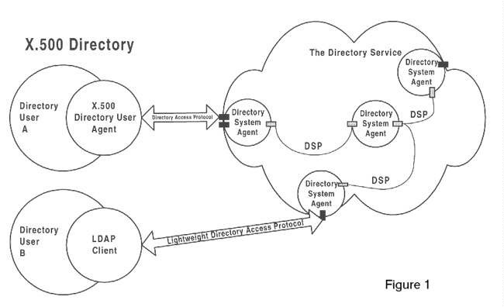
X.500 Directory
X.500 Directory Service is a standard way to develop an electronic directory of people in an organization so that it can be part of a global directory available to anyone in the world with Internet access.

Slide 5

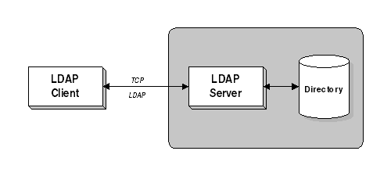
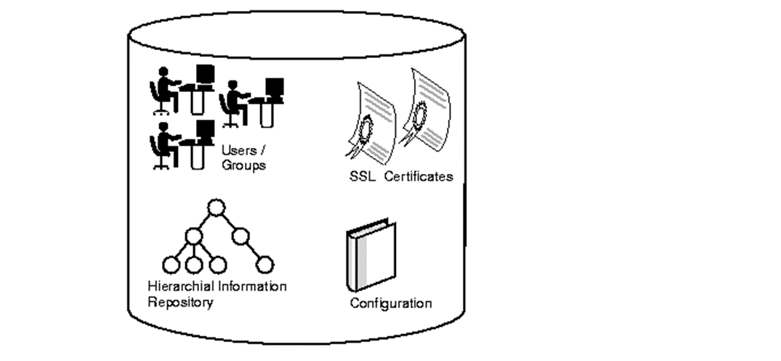
What is LDAP?
Lightweight Directory Access Protocol(LDAP) is a server or client/server protocol used to access and manage directory information.
In order to commence LDAP session, a client needs to connect to the LDAP server, which is set by default to TCP port 389 or UDP port 389

Slide 6
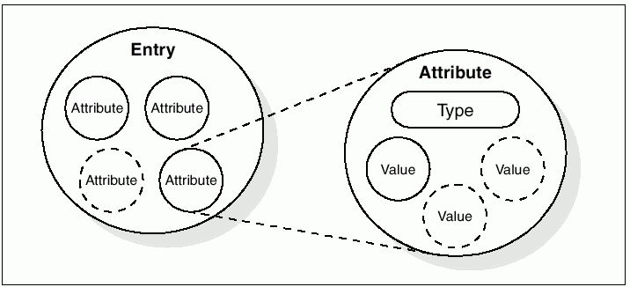
LDAP Information Storage:
Attributes hold the data for an entry.
Each attribute has an attribute type.

Slide 7
Simplifies X.500 functional modes.
Allows use of multiple directories.
Relieves burden of client.
Open source with flexible architecture
Advantages
&
Disadvantages
Updates and patches aren’t released on a regular basis.
Require additional protection such as SSL connection to LDAP server.

